Slide 1
Black-Litterman Model
With Machine Learning derived
Haoyu Guan
Yishuang Bao
Ruizhe He
Ziqi Chen
Yifei Zhang

Slide 2
What is the Black-Litterman Model?
The Black-Litterman Model is used to determine optimal asset allocation in a portfolio
Black-Litterman Model takes the Markowitz Model one step further
  It uses a Bayesian approach to combine the subjective views of an investor regarding the expected returns of one or more assets in the market.

Slide 3
Data Selection
EFA: tracks developed markets(market excluding U.S.)
EEM: tracks emerging markets
GLD: represent the gold market
IYR: represent the US Real Estate Market

Slide 4
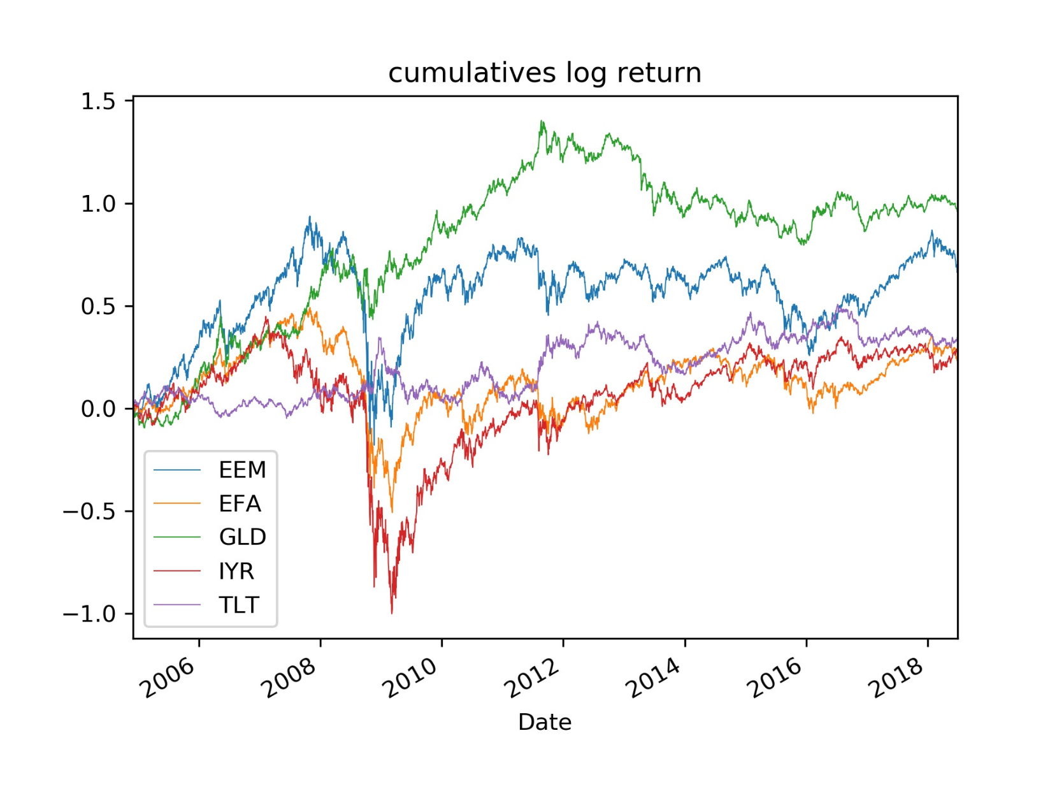

Slide 5
Time Period
Weekly data
From Dec. 2004 to Jun.2018 from Yahoo Finance
This period includes:
one full bear market : 2007-2009
two bull markets : 2004-2007 and 2009-2013

Slide 6
Rolling Window
Our rolling window are 150 days.
We use the past 150 days’ data to generate log-return, matrix Q and all the parameter.
Back testing Process

